Slide 1

Stock Price Prediction Model
By
Waseem Ahmed

Slide 2
Objective
Collect stock data of Sensex
Build and Optimize Various Prediction Models
Forecast next 30 days price

Slide 3
LifeCycle of The Project
Scrape Financial Data From Yahoo and ticker tape
1
Format the data for Data Analysis
2
Clean the data for repeated prices caused due to weekdays and holidays
3
Build model.
4
Train and Fit Models
5
Optimize the models

Slide 4
Scraping Process
Targeting
Targeting finance.yahoo.com for Historical data
Cleaning and Formatting
Cleaning and Formatting the scraped dataset
Checking
Checking for discrepancies.

Slide 5
Prediction Models
Implemented Arima
Implemented FB-Prophet
Implemented Stack LSTM

Slide 6
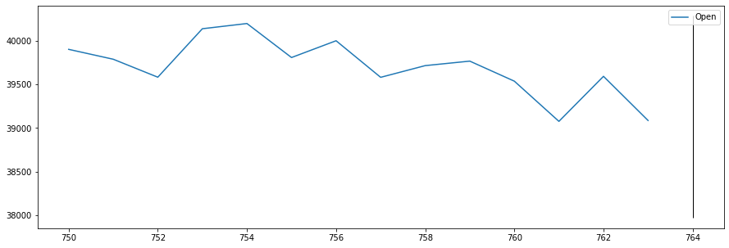
Results
Arima Model Forecasting for the next 30 days with 95% confidence

Slide 7
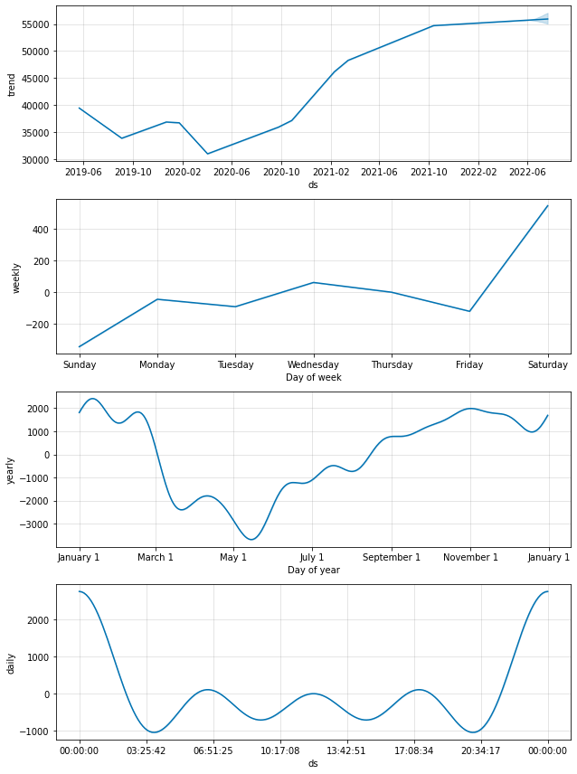
FB-Prophet forecasting for next year

Slide 8
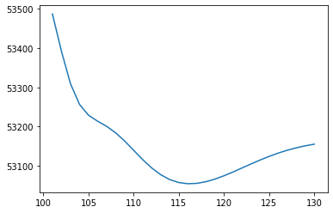
Stack LSTM forecasting for next 30 days
On adjusted close

Slide 9
Future Work
Calculate Risk
01
Implement Various Risk Factors
02
Improve Forecasting Results
03

Slide 10

Thank You

